Slide 1
Consultancy House (A Financial Consultancy Website) Developed at SILVER TOUCH TECHNOLOGIES LTD. DEVELOPED BY:- SHARVILAK THAKORE (ID-11CEUOS098)
EXTERNAL GUIDE: INTERNAL GUIDE:
Mr. Sahil Nagpal Prof. Mrudang T. Mehta

Slide 2
Objectives of Consultancy House
To create an online finance related consultancy and E-Commerce website.
To bridge the gap between consultant and clients.
Simplicity in design and easy to use functionalities
Security should be maintained.

Slide 3
Technologies Used:
ASP.NET Framework 4.0 with C#
ASP.NET web forms
ASP.NET web user controls
Class libraries
CSS & JavaScript files
MS-SQL Server 2008 Express

Slide 4
How does it work?
Admin
Client
Visitor
There are 3 modules:
Admin
Client
Visitor

Slide 5
Features of Consultancy House
Client
Place Request
View News
Download Product
PayPal
View Enquiries
View Premium orders
Manage News
Manage Products
Manage Requests
Manage Users
Admin
Store
Download Result
Visitor
Submit Enquiry
Access external pages
Translate pages

Slide 6
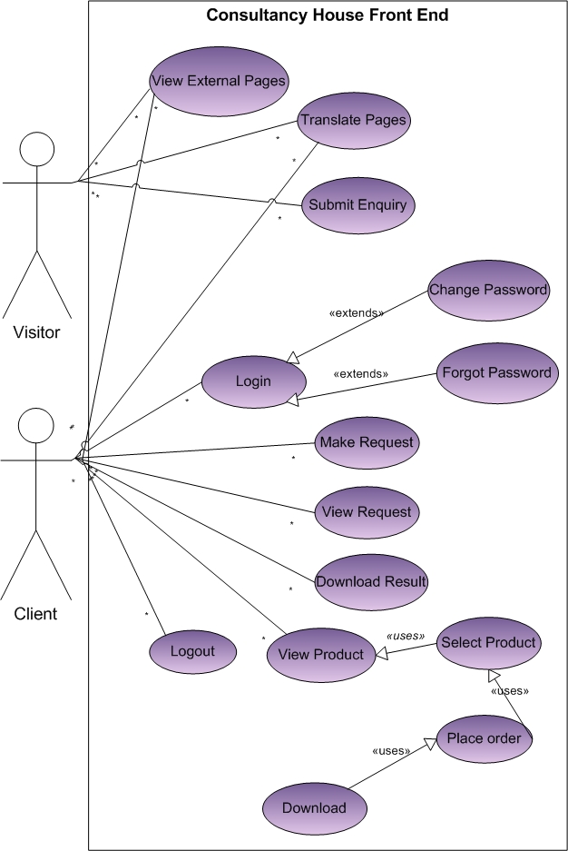
Use Case

Slide 7
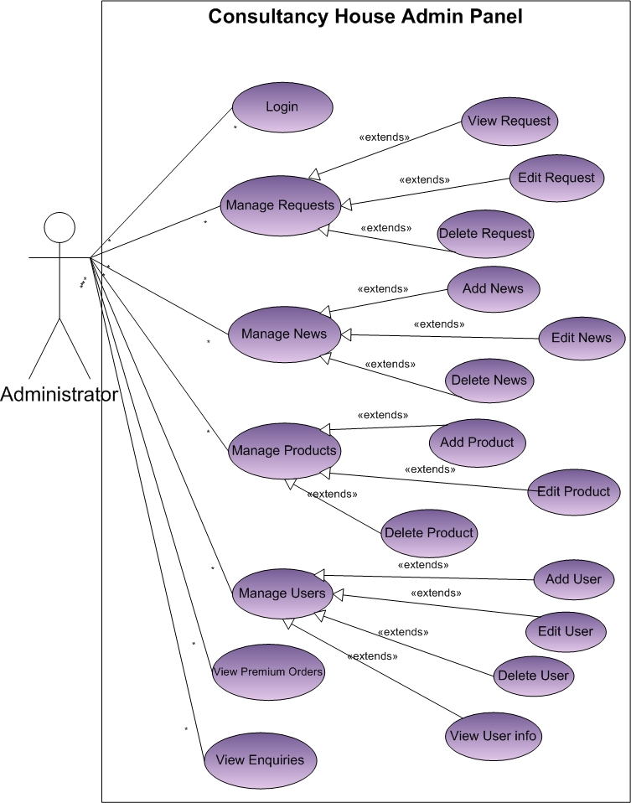
Use Case

Slide 8
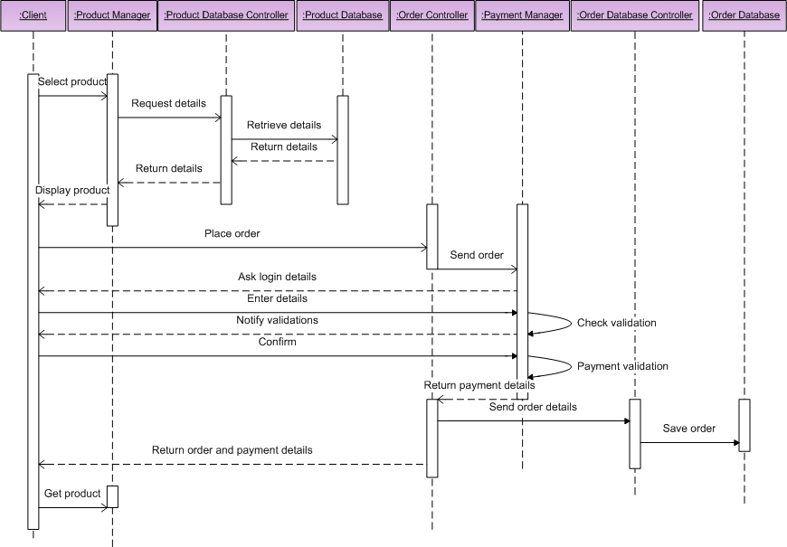
IMPORTANT SEQUENCE DIAGRAMS: Client: Payment

Slide 9
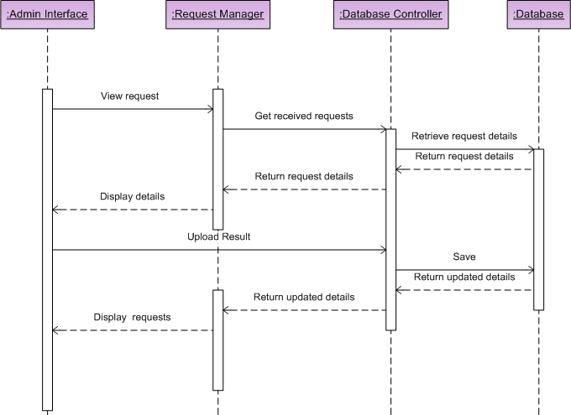
IMPORTANT SEQUENCE DIAGRAMS: Admin: Manage Requests

Slide 10
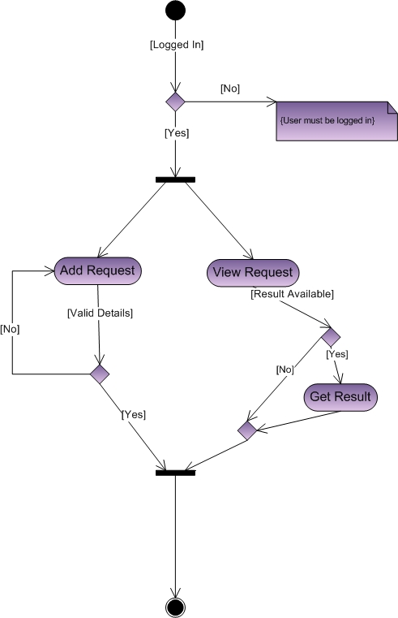
IMPORTANT ACTIVITY DIAGRAMS: CLIENT: PLACE REQUEST

Slide 11
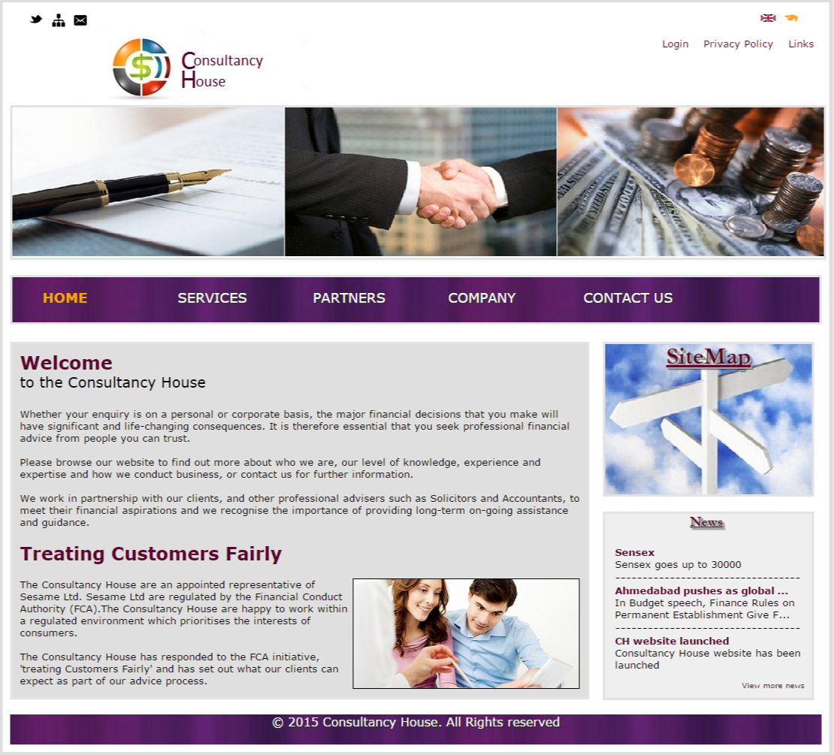
HOME PAGE

Slide 12
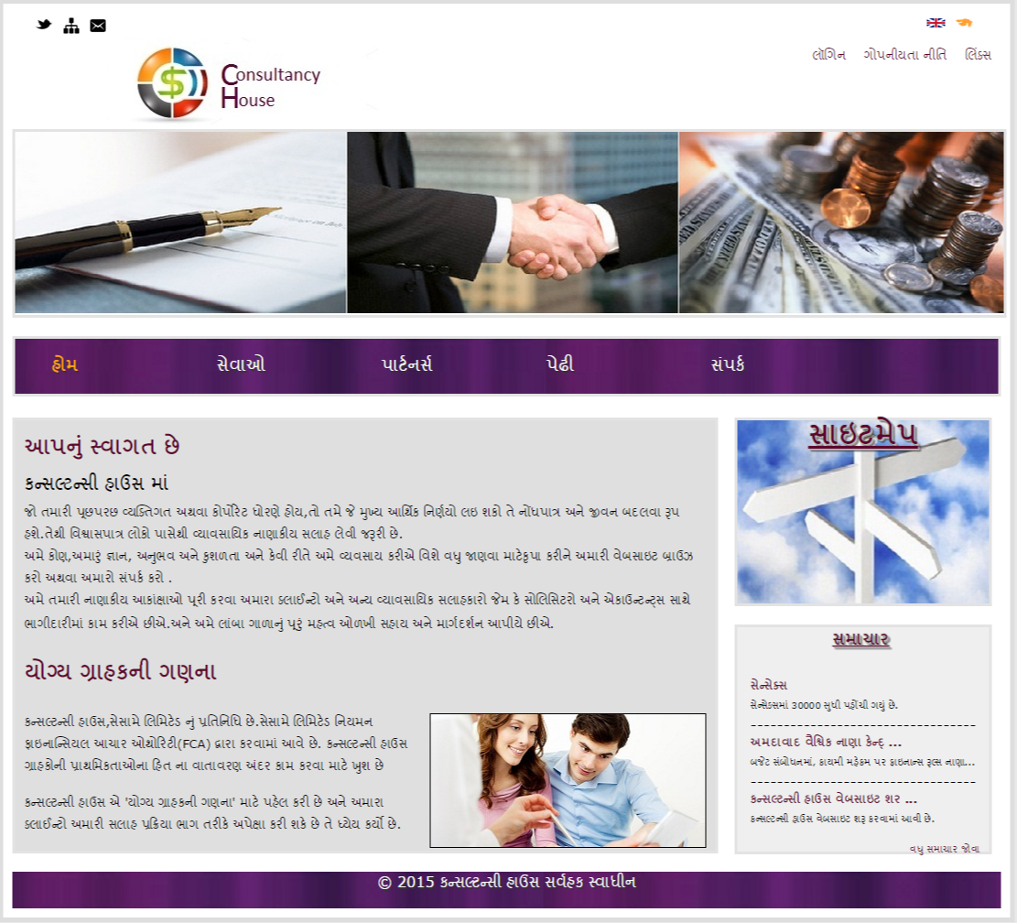
HOME PAGE IN GUJARATI

Slide 13
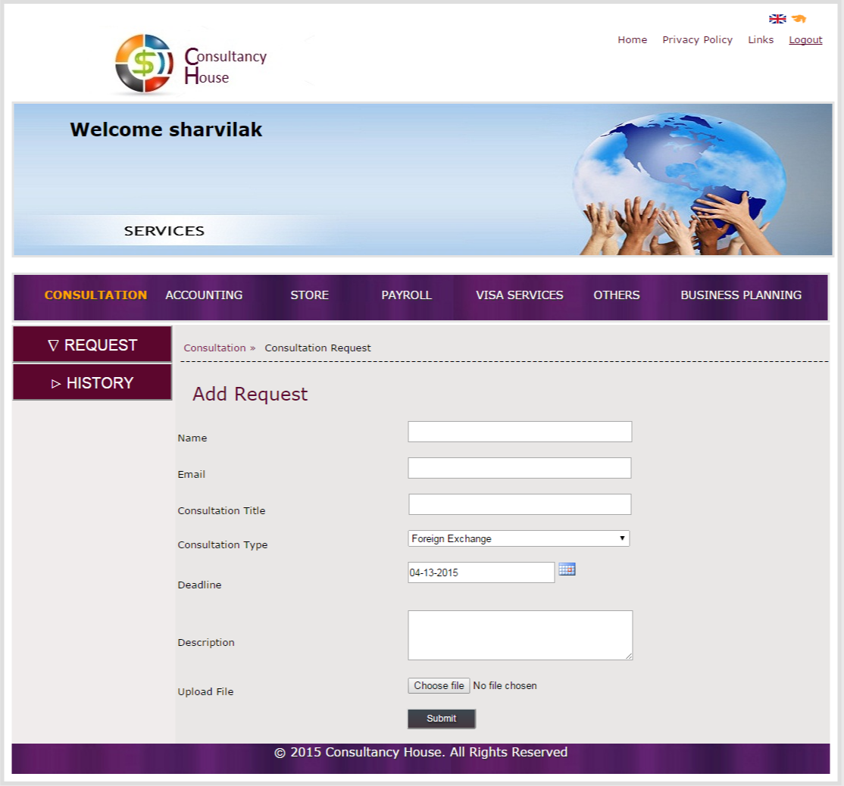
SERVICES : ADD REQUEST

Slide 14
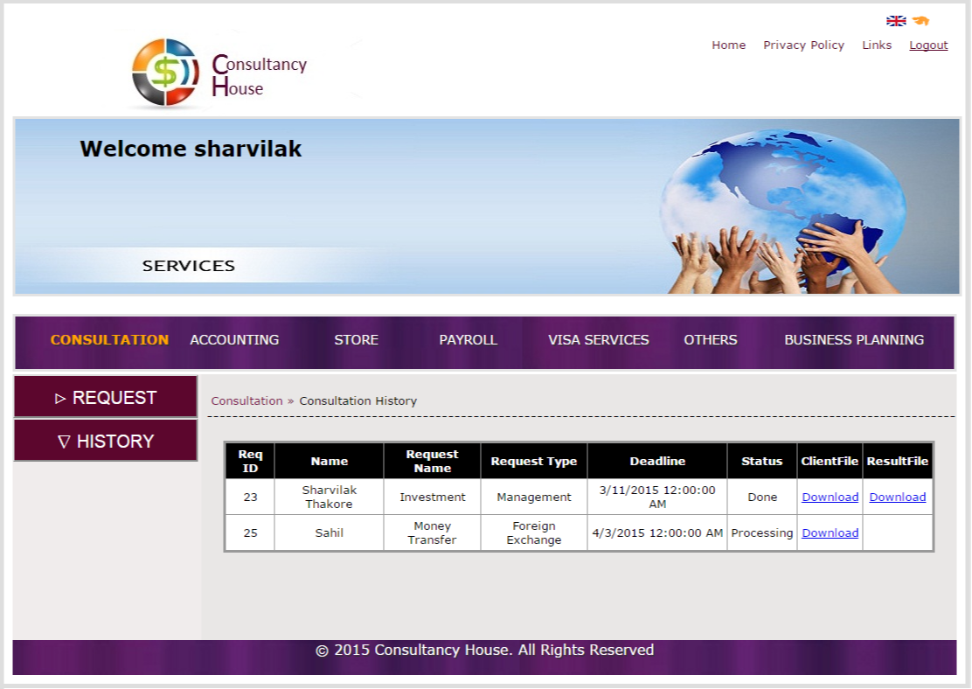
SERVICES : REQUEST HISTORY

Slide 15
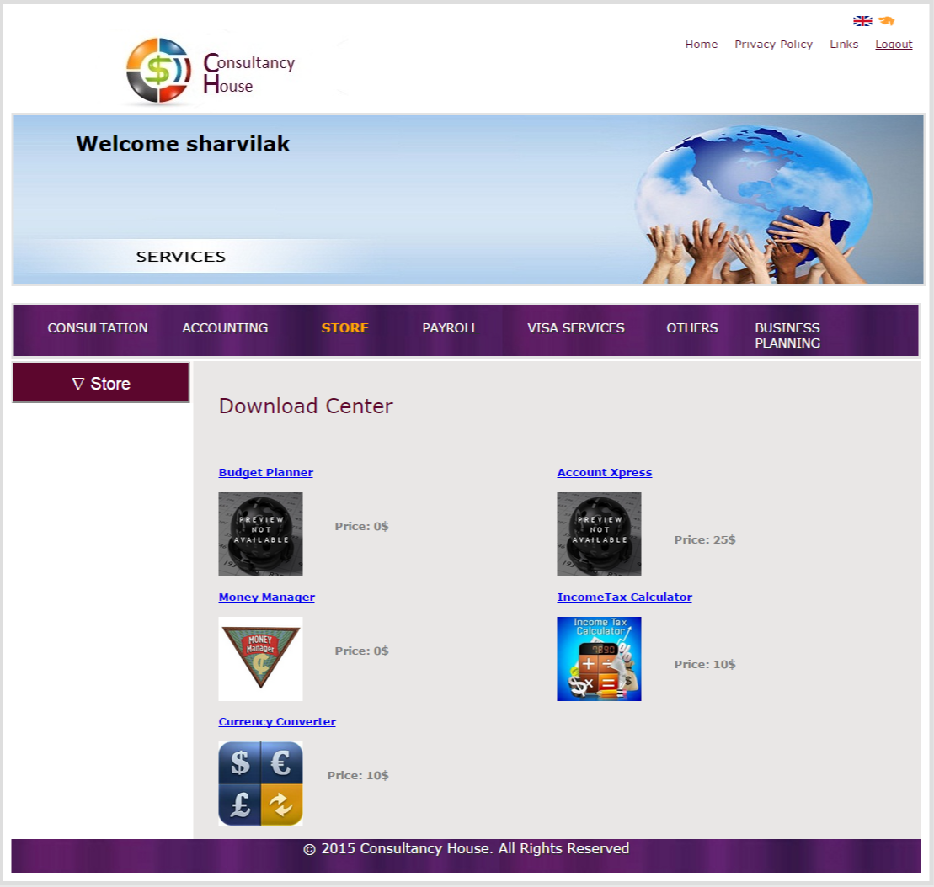
SERVICES : STORE

Slide 16
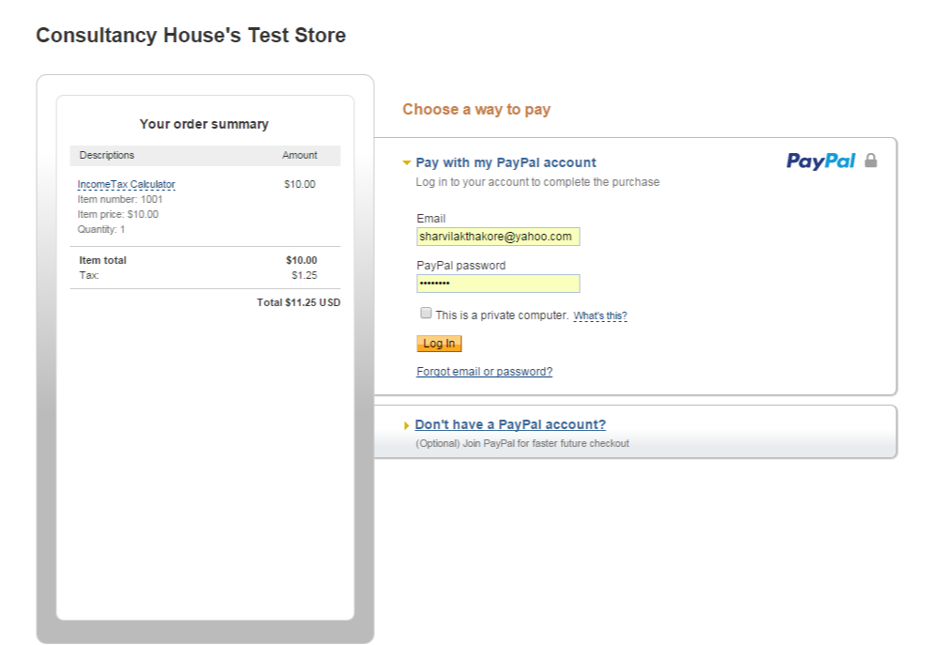
SERVICES : PAYMENT GATEWAY

Slide 17
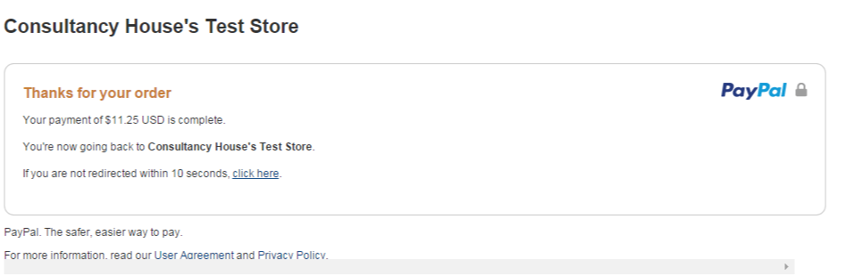
SERVICES : PAYMENT GATEWAY

Slide 18
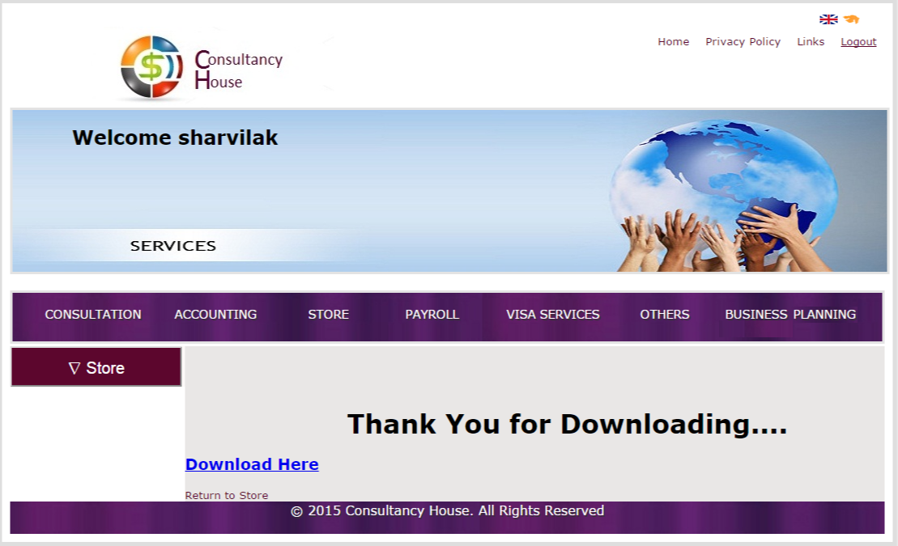
SERVICES : DOWNLOAD PRODUCT

Slide 19
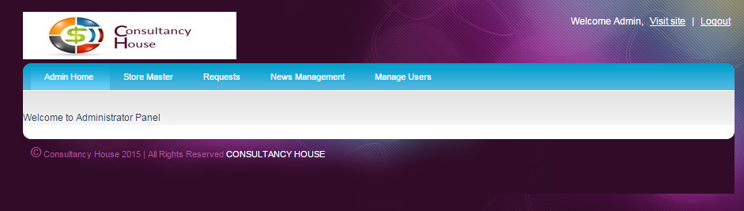
ADMIN HOMEPAGE

Slide 20
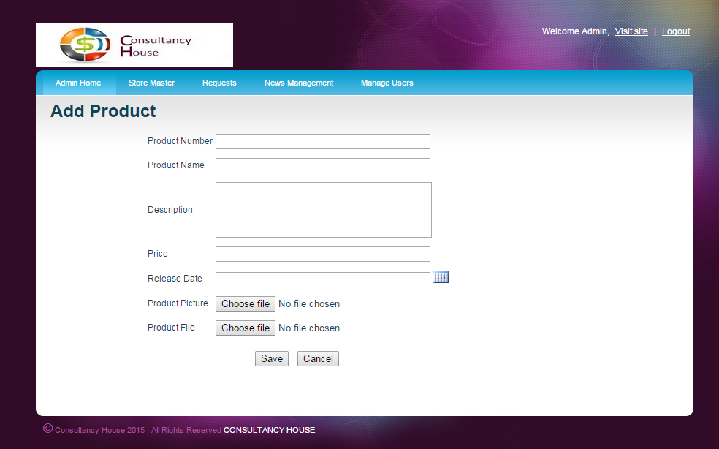
ADD PRODUCT

Slide 21
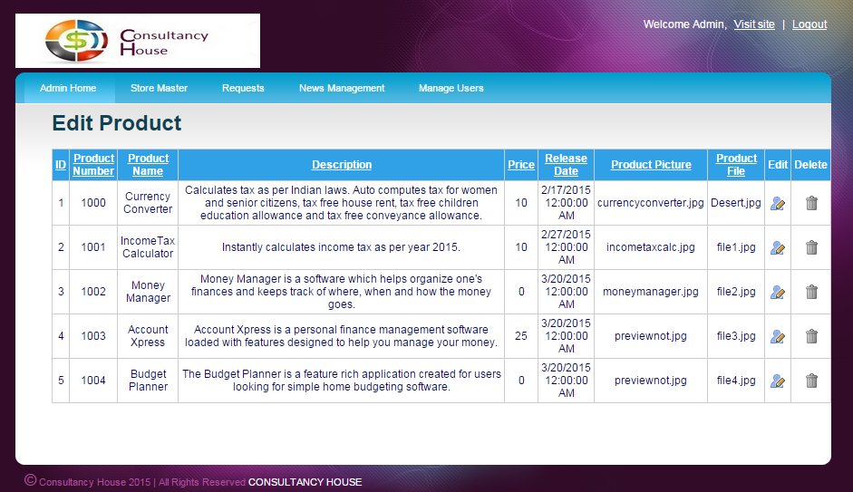
EDIT PRODUCT

Slide 22
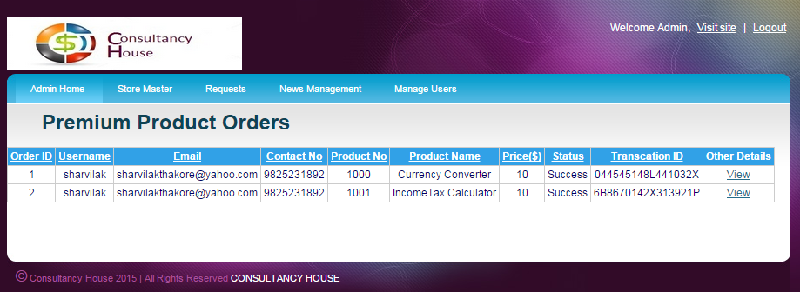
PREMIUM ORDERS

Slide 23
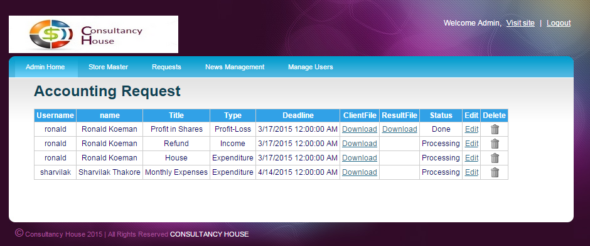
VIEW REQUEST

Slide 24
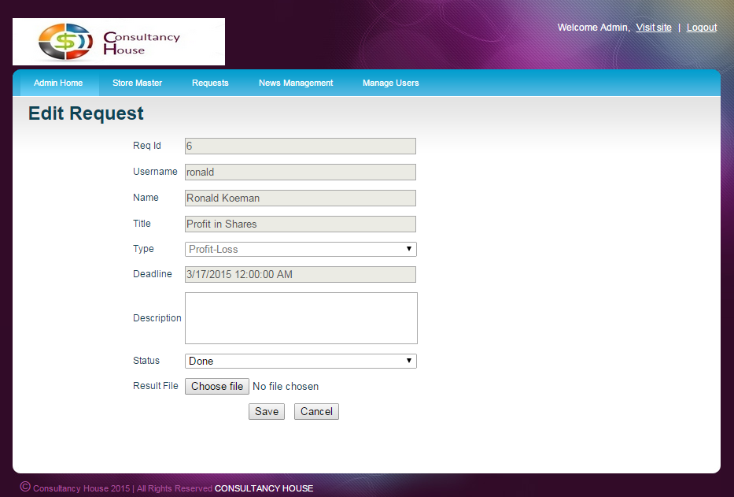
EDIT REQUEST

Slide 25
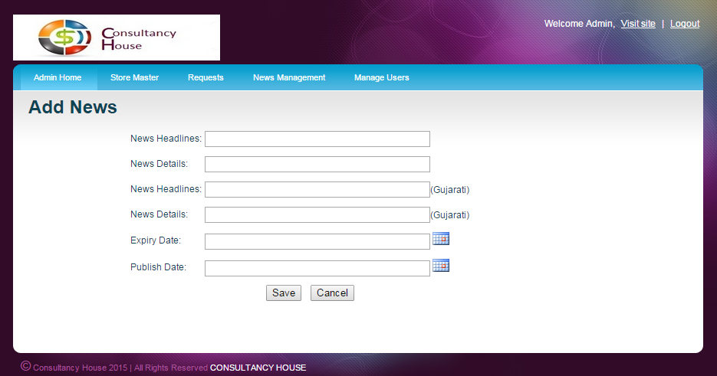
ADD NEWS

Slide 26
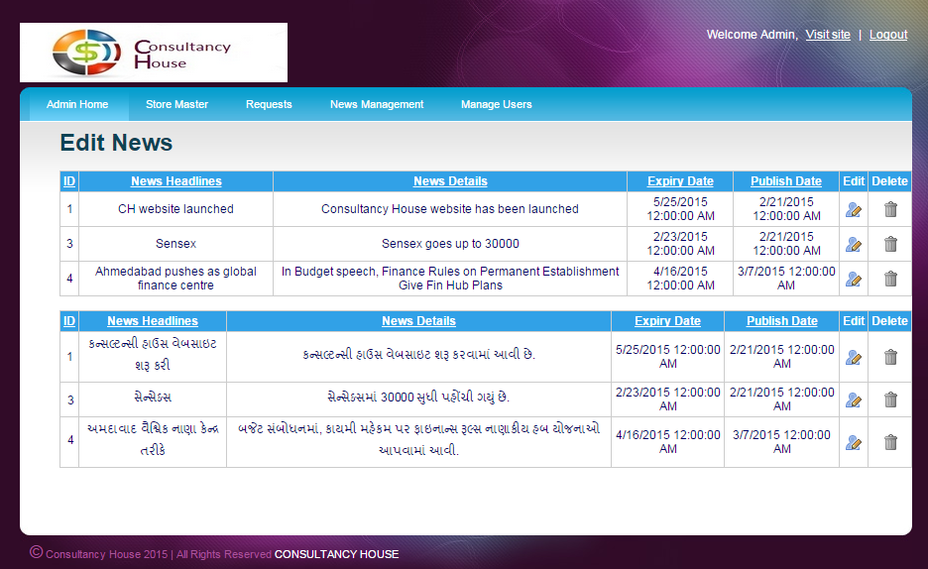
EDIT NEWS

Slide 27
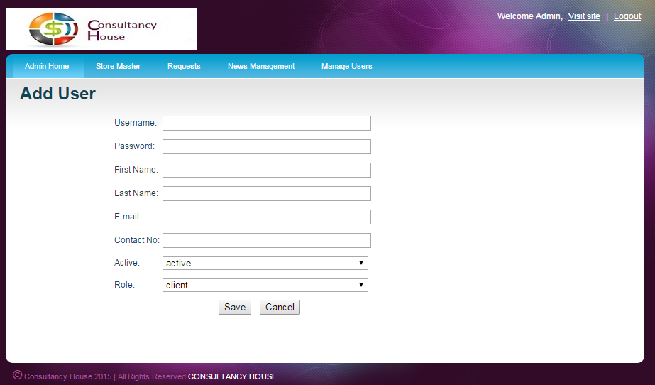
ADD USER

Slide 28
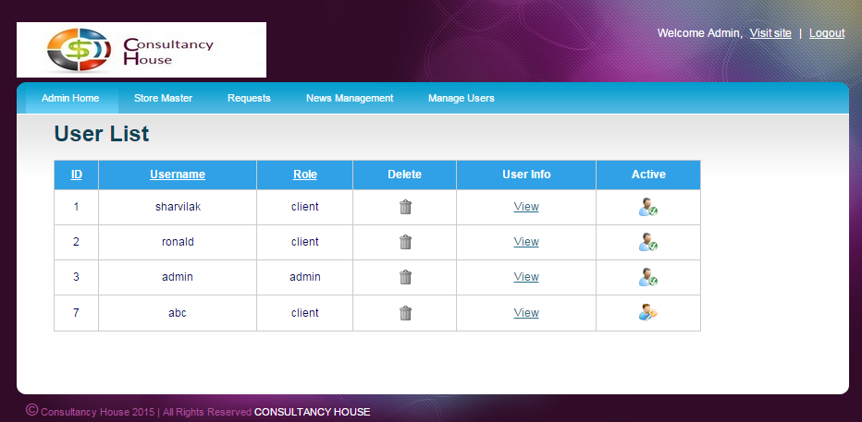
EDIT USER

Slide 29
TEST CASES: CLIENT
TEST CASE | STATUS
Client Login | PASS
Add Request | PASS
View Request | PASS
Download Result | PASS
View News | PASS
View Product | PASS
Payment | PASS
Download Product | PASS
Translate External Pages | PASS

Slide 30
TEST CASES: ADMIN
TEST CASE | STATUS
Admin Login | PASS
Manage Requests | PASS
Upload Result | PASS
Manage Products | PASS
Manage News | PASS
Manage Users | PASS
Contact Us Notification | PASS
View Premium Orders | PASS

Slide 31
Conclusion
FUTURE ENHANCEMENTS:
More professional.
News Letter facility.
Live Chat with consultant.
More finance services.
More languages support.
PROBLEMS FACED:
PayPal integration
Management of client’s files on server.
Management of contents in two different languages.

Slide 32
References
https://msdn.microsoft.com
www.aspsnippets.com
www.cacoo.com
www.stackoverflow.com

Slide 33
THANK YOU…..

